Slide 1
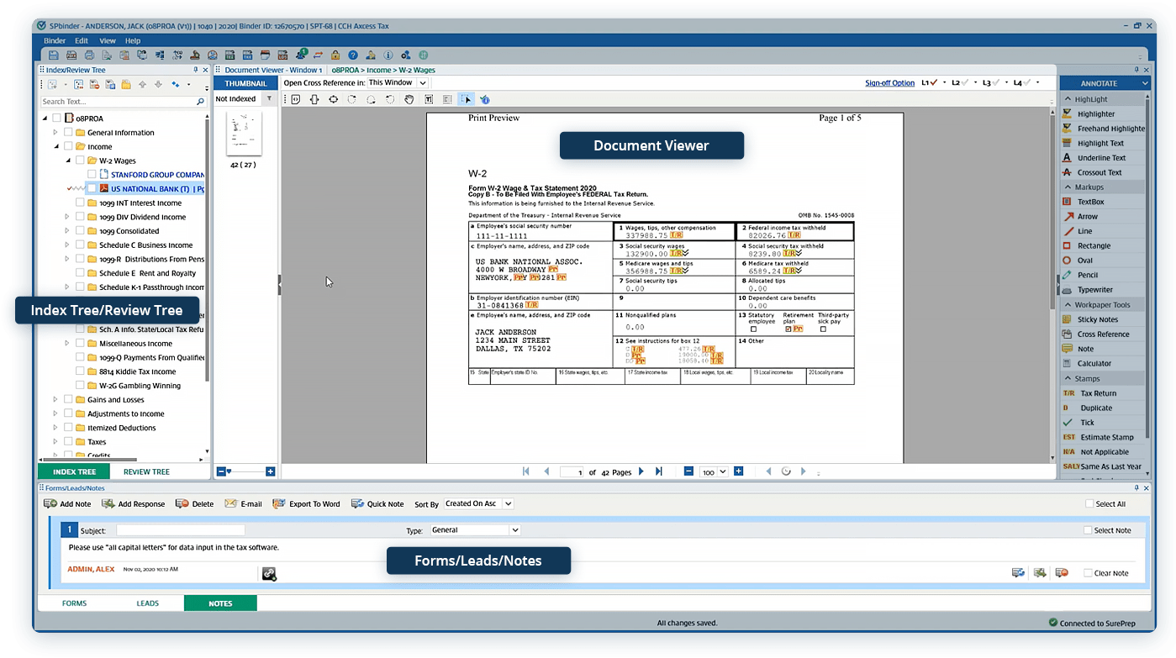
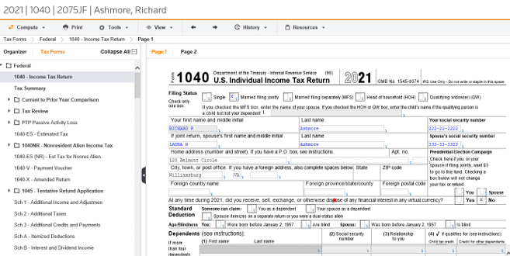
Software Experiences at BDO
Alex Savisky – Core Tax Services Intern, BDO
Responsibilities:
Preparing client tax documents & returns
Adjusting and disposing of client assets
Tax research on various topics
What I’ve learned:
Different software/technologies
Prepare different entities tax documents
Importance of communication
Use time more effectively
SurePrep Features:
Index client documents
Sign off documents as reviewed
Prepare client tax forms
Learning experience, challenge, and solution:
Learned through use & trainings
Challenged importing to GoSystem
Resolved by shadowing associates
Tips to learning the software:
SurePrep university trainings
Taking notes on demonstrations
Shadowing with associates
GoSystem Features:
Prepare client tax forms
E-file extensions/returns for processing
Print client tax forms and documents
Learning experience, challenge, and solution:
Learned through use & trainings
Challenged fixing diagnostic error
Resolved with trial & error
Tips to learning the software:
Taking detailed notes
Attending company wide trainings
Asking questions
Key Takeaways
Industry lessons:
Urgency and pace of busy season
Company lessons:
Review process
Billable hours expectations
Career process:
Actions & decisions needed to receive a full-time offer
Importance of feedback from project leads
Self Reflection:
Importance of adaptability
Working better as a team
Ask as many questions as possible

